Slide 1
Technology Mapping

Slide 2
Technology Mapping
Perform the final gate selection from a particular library
Two basic approaches
1. ruled based technique
2. graph covering technique

Slide 3
Technology Mapping
Create subject graph
  transform a given graph to a subject graph using only gates in the base function

Slide 4
Technology Mapping
choice of base function
  functionally complete
  ex: AND-OR-NOT
  NOR-NOT
  NAND-NOT
  the decision of base function influences the number of patterns needed to represent the library
ex: to represent a cell f=(ab+cd)’
if base function (NAND,NOR,INV)
- 3 NAND gate, 1 INV
- 3 NOR gate, 4 INV
    - .........
if base function (NAND,INV)
- one pattern only

Slide 5
Technology Mapping
  the granularity of the base function affects the optimization potential
  ex: f=abcd+efgh+ijkl+mnop
  4-input nand gates
  => one mapping
  2-input nand gates
  => 18 mappings
  A fine resolution base-function allows for more cover and thus better quality

Slide 6
Graph Covering (Mapping)
DAG covering is NP-hard
Heuristic to solve the problem (tree covering)
1. Partition the subject graph into trees
2. Cover each tree optimally (Dynamic
Programming)

Slide 7
Graph Covering (Mapping)
Step 2:
library
Subject graph
Bottom-up
For each nodes
. find all matching which
rooted at v
. select the best matching
which has the least cost
inv(2)
nand2(3)
AOI21(4)

Slide 8
Graph Covering (Mapping)
Step 1:
(a) Graph => tree
weak points:
loss of global view due to the step of
partition into trees
cover cross bounding is not allowed
xor type gate can not be explored

Slide 9
Graph Covering (Mapping)
(b)
  only primary output is selected as root
  the mapping starts at a primary output
  mapping continues until either a primary input is encountered or until another internal node that already mapped is encounter which is an output of a cell
  select the most critical output first (mapping without interruption)

Slide 10
Technology Mapping Minimizing Area under Delay Constraint
Minimize area subject to constraints on signals arrival times at the output.
Two steps:
(1) Compute delay function (arrival time-area
trade off curve) at all nodes bottom up
(2) Generate the mapping solution based on
the delay function and required time at
each nodes top down

Slide 11
Technology Mapping Minimizing Area under Delay Constraint
Step 1: (postorder traversal)
1. At each node, compute the area as a function of arrival time.
Delay function computation:
Let Gate G (a mapping) have inputs A,B
  a) select a point from delay function of one input (A)
  b) look for a point on the delay function of the other node(B) with “less delay” & ”minimum area”
  c) combine these two points
  arrival time(G) = arrival time(A) +
  delay(y)
  area(G) = area(A) + area(B) + gate(g)

Slide 12
Technology Mapping Minimizing Area under Delay Constraint
2. Lower bound merge process
  delete inferior points
  inferior point p* = (t*,n*)
  if there exists a point p = (t,a),
  t > t* and a* > a
Step 2:
Timing recalculation (shift the delay curve)
Step 3:
According to the delay function and required
time, select mappings. (preorder traversal)

Slide 13
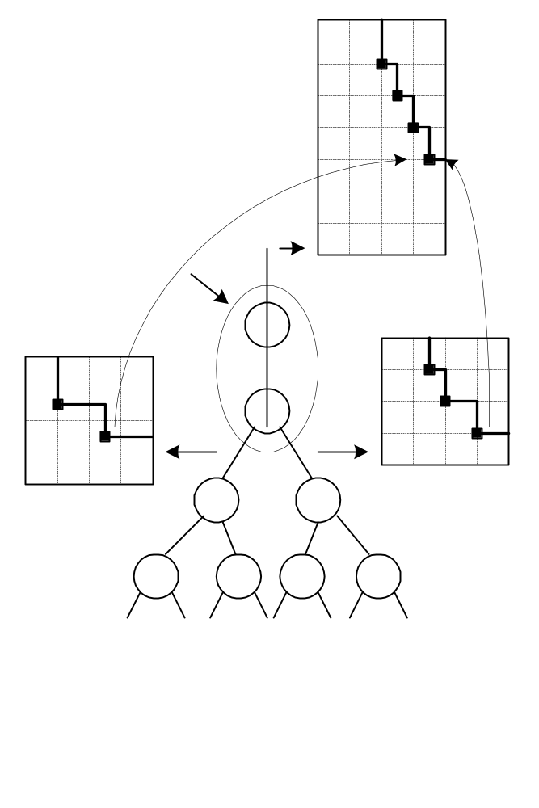
c’
b’
area
d’
a’
gate delay = 1/2
gate area = 1/2
delay
D
c
e
b
area
d
C
a
delay
B
A
Generating the delay curve for a given match

Slide 14
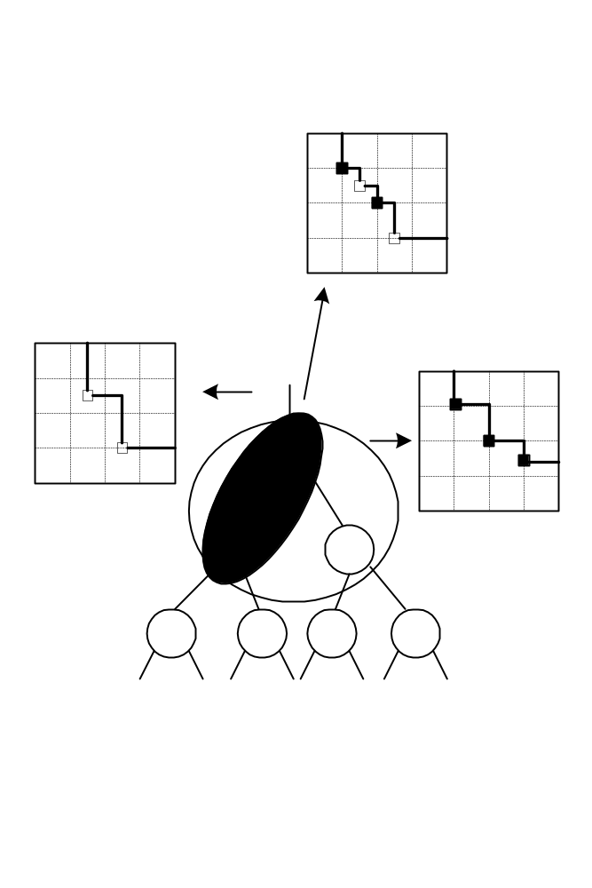
a
area
d
b
/* point c becomes inferior point */.
e
delay
merged delay curve due to g1 & g2
d
a
area
area
e
b
c
C
delay
g1 g2
delay
delay curve due to
match g1
B
A
Lower bound merging of delay curves

Slide 15
Technology Mapping for FPGA

Slide 16
Technology Mapping for FPGA
Interconnection
Resources
Logic Block
I/O Cell
Fig.1.1- A Conceptual FPGA.
FPGA : Field Programmable Gate Arrays

Slide 17
Technology Mapping for FPGA
Inputs
X
A
B
C
D
Look-up
Table
Y
s
Outputs
D
Q
R
Note:
= User-programmed
Multiplexor
XC2000 CLB

Slide 18
Technology Mapping for FPGA
e
f
c
(a+b)’(c’e+cf)
+(a+b)(d’g+dh)
g
h
d
a b
Figure 3.19- Act-1 Logic Block.

Slide 19
Technology Mapping for FPGA
Traditional Logic Synthesis Tools:
Logic description
literal counts as criterion
f1=x₁ | x₂ | x₃ | x₄ | x₅ | x₆
f2= x₁ x₂’ x₃’ x₄’ x5’|
x1’ x₂ x₃’ x₄’ x5’
...| x₁ x₂ x₃ x₄ x₅
Decomposition process
Technology mapping
gate library
(For a 5-input RAM cell,
2² gates are needed.)
5
A mapped logic description
( a general graph)

Slide 20
Technology Mapping for FPGA
Some Features of the FPGA:
(1) Configurable function units and interconnections.
(2) Function units are implemented using lookup tables. ( Number of literals are not so important any more
Ex: f₁ = abcdef
f₂ = abcde + b’d + ab’c + bcd’)
(3) Restricted interconnections.

Slide 21
Technology Mapping For FPGA
1. Decomposition
k=3
F
G
f
g
y
x
a
b
c
d

Slide 22
Technology Mapping For FPGA
2. Covering
k=5
a) With forced merge, 2 LUTs
b) Without forced merge, 3 LUTs

Slide 23
Technology Mapping For FPGA
a) Without replicated logic, 3 LUTs
b) With replicated logic, 2 LUTs

Slide 24

MIS-PGA
1. SIS standard script optimization
2. Decomposition so that each intermediate node with input less that K(input constraint of a logic cell)
  Roth-Karp decomposition
  partition
    kernel extraction
  f = c_{i}k_{i}+r_{i}
  cost(k_{i}) =
    and-or decomposition
    f = ab+bc+cd
    => g = bc+cd
    f = ab+g
f

Slide 25
Unate Covering
A covering problem where the coefficients of the matix is 0 or 1 and row i is covered if column A_{j} is selected.
(ie. select a set of A_{i} so that all row a_{i}s are covered)
A₁ A₂ A₃
a₁ 1 1
a₂ 1 1
a₃ 1 1
c = { A₁, A₃ } or c = { A₂, A₃ }

Slide 26
Binate Covering
A covering problem where the coefficient of the matrix can be -1, 0, 1 and row a_{i} is covered if column A_{j} is selected and a_{ij}=1 or A_{j} is NOT selected and a_{ij}=-1.
A₁ A₂ A₃
a₁ 1 1
a₂ 1 1
a₃ 1 1
a₄ -1
c = { A₁,A₃ }

Slide 27
Covering
Covering
  find all supernode(i) for each node i
  Supernode(i) : a cluster that rooted at i and some nodes in the transitive fan-in of i. The constraint is that it has a maximum of m inputs.
supernode

Slide 28

Covering
use maxflow to find supernodes :
Because we are going to
find node cut set,
For each node i:
Different construction of
network will result in
different cut-set.
1

Slide 29
Binate Covering
S₅
n₆
S₁
n₁
n₇
n₂
n₃
S₂
S₄
S₃
n₄
n₅
Covering constraint:
Every intermediate node should be included in
at least one selected FPGA node
Implication constraint:
If a supernode is chosen, each input to the
supernode must be chosen.
Output constraint:
For every primary output, one supernode rooted
at the outputs should be selected.

Slide 30
Example
S₅
n₆
S₁
n₁
n₇
n₂
n₃
S₂
S₄
S₃
n₄
n₅

Slide 31
Binate Covering
(一) Covering constraint
For every intermediate node, we construct
a row.
The column index is the node of supernode
If n_{i} intermediate node is covered by
supernode S_{j}, then M_{ij} = 1
Example :
S₁ S₂ S₃ S₄
n₁ 1
n₂ 1
n₃ 1 1
n₄ 1

Slide 32
Binate Covering
(二) Implication constraint:
For every input j to the supernode S_{i}
one row has to be added.
entry under M_{j Si} = -1 and
all supernode Sja has j as output M_{j Sja} = 1

Slide 33
Example
S_{i} ...... S_{j1}....S_{j2}
j1 -1 1
j2 -1 1
S_{i}
_{j1}
_{j2}
S_{i}... S_{ja}.. S_{jb}...
j -1 1 1
S_{i}
j
S_{ja}
S_{jb}

Slide 34
Binate Covering
(三) Output constraint:
For every primary output, we should
create a row so that one supernode
rooted at the output will be selected.
primary output
S₁
S₂
S_{i} ..... S_{j}
O₁ 1 1

